Slide 1
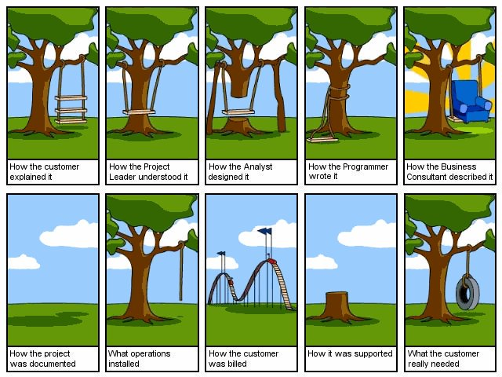

Slide 2


Slide 3
Project
A temporary endeavor undertaken to create a unique product, service, or result.
It has:
  Defined start and end dates
  Specific objectives
  Allocated resources
  Constraints (time, cost, scope)
  Example: Developing a mobile app, implementing an ERP system.

Slide 4
Is going for a movie or having breakfast a project?
Going for a movie:
  Usually NOT a project because it’s a routine activity, no unique deliverable, no formal planning.
  Unless you are organizing a movie event for 500 people → then it becomes a project.
Having breakfast:
  NOT a project because it’s a daily operational activity.
  If you are designing a new breakfast menu for a restaurant launch, that’s a project.
What is NOT a Project?
  Ongoing operations or repetitive tasks.
  Activities without a clear end goal or uniqueness.
  Examples of NOT a project:
    Daily customer support
    Routine maintenance
    Regular accounting tasks

Slide 5

Definition and Importance of IT Project Management
Definition of IT Project Management
  Project Management is the application of knowledge, skills, tools, and techniques to project activities to meet the project requirements. It involves initiating, planning, executing, monitoring & controlling, and closing projects. The goal is to deliver a unique product, service, or result within defined scope, time, cost, and quality constraints.
Alignment with Business Goals
  IT project management aligns technology initiatives with business objectives to maximize value and minimize risks.
Risk Reduction and Efficiency
  Effective management reduces risks like scope creep and budget overruns, ensuring smooth project execution.
Use of Methodologies and Frameworks
  Applying proven methodologies helps achieve predictable outcomes and enhances stakeholder satisfaction.
Notes:
IT Project Management refers to the discipline of planning, organizing, and managing resources to successfully deliver information technology projects. It encompasses defining objectives, allocating resources, and ensuring that deliverables meet quality standards within the agreed timeline and budget. The importance of IT project management lies in its ability to align technology initiatives with business goals, reduce risks, and optimize resource utilization. Effective IT project management ensures that complex projects such as software development, cloud migration, or infrastructure upgrades are executed efficiently. For example, implementing a large-scale IT system across multiple departments requires careful coordination to avoid downtime and ensure compatibility. Without structured management, projects can suffer from scope creep, budget overruns, and missed deadlines, ultimately impacting business operations. By applying proven methodologies and frameworks, organizations can achieve predictable outcomes, enhance stakeholder satisfaction, and maintain competitive advantage in a rapidly evolving technological landscape.

Slide 6
Five Process Groups (PMBOK)
Initiating – Define the project and get authorization.
Planning – Establish scope, objectives, and course of action.
Executing – Perform the work defined in the plan.
Monitoring & Controlling – Track, review, and regulate progress.
Closing – Finalize all activities and formally close the project.

Slide 7
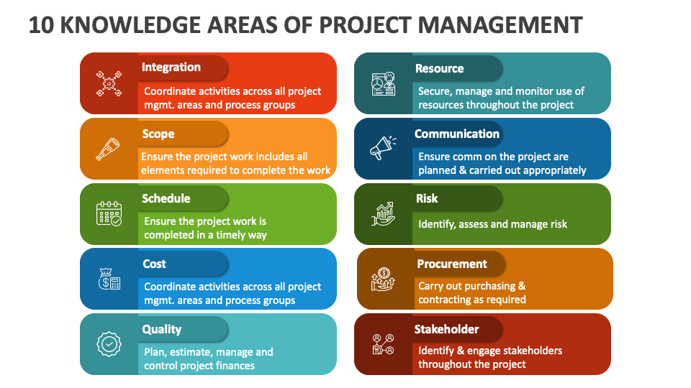

Slide 8
Differences between IT Projects and Traditional Projects
Aspect | IT Projects | Traditional Projects
Deliverables | Software, systems, digital solutions | Physical structures, tangible products
Complexity | High, due to technology integration | Moderate, predictable processes
Risk Factors | Cybersecurity, rapid tech changes | Material delays, labor issues
Methodologies | Agile, Scrum, DevOps | Waterfall, traditional PM
Notes:
IT projects differ significantly from traditional projects in terms of complexity, dependency on technology, and risk factors. Traditional projects, such as construction or manufacturing, often involve tangible outputs and predictable processes. In contrast, IT projects deal with intangible deliverables like software applications or network systems, which require specialized technical expertise and adaptability to changing requirements. IT projects are more prone to rapid technological changes, integration challenges, and cybersecurity concerns. For instance, implementing an ERP system involves coordinating multiple modules, ensuring data integrity, and managing user adoption, whereas building construction focuses on physical structures with well-defined standards. Additionally, IT projects often face higher uncertainty due to evolving business needs and emerging technologies, making iterative approaches like Agile more suitable than rigid methodologies. Understanding these differences helps project managers select appropriate tools, frameworks, and risk mitigation strategies to ensure successful outcomes.

Slide 9

Project Manager

Slide 10
Project Manager - Roles
A Project Manager (PM) is the person responsible for planning, executing, and closing projects. They ensure the project meets its objectives within the defined scope, time, cost, and quality constraints.
Planning
  Define scope, objectives, and deliverables.
  Example: Creating a project plan for a cloud migration.
Organizing Resources
  Assign tasks, manage budgets, and allocate resources.
  Example: Assigning developers for an ERP implementation.
Monitoring & Controlling
  Track progress, manage risks, and ensure quality.
  Example: Using dashboards to monitor sprint progress in Agile.
Communication
  Keep stakeholders informed and engaged.
  Example: Weekly status reports to executives.
Risk Management
  Identify, analyze, and mitigate risks.
  Example: Planning for server downtime during deployment.

Slide 11
Project Manager - Skills
Technical Skills
  Knowledge of project management tools (MS Project, Jira, Trello).
  Example: Using Jira for Agile sprint tracking.
Leadership Skills
  Motivating and guiding the team.
  Example: Leading a cross-functional team for a mobile app launch.
Communication Skills
  Clear and effective communication with stakeholders.
  Example: Explaining technical issues to non-technical executives.
Problem-Solving Skills
  Handling unexpected challenges.
  Example: Resolving resource conflicts during peak development.

Slide 12
Project Manager - Skills
Time Management
  Prioritizing tasks and meeting deadlines.
  Example: Delivering a software release before a product launch event.
Negotiation Skills
  Balancing stakeholder expectations and team capacity.
  Example: Negotiating additional time for testing with the client.
Adaptability
  Adjusting plans when requirements change.
  Example: Switching from Waterfall to Agile mid-project.

Slide 13
Project Management Frameworks (PMBOK, PRINCE2, Agile)
Framework | Key Features | Best Use Case
PMBOK | Process-based, comprehensive knowledge areas | Large-scale, structured projects
PRINCE2 | Governance, defined roles, stage-based | Projects requiring strict control
Agile | Iterative, flexible, customer-focused | Software development, dynamic environments
Notes:
Several frameworks guide IT project management, each offering unique principles and processes. PMBOK (Project Management Body of Knowledge) provides a process-based approach emphasizing knowledge areas like scope, time, and cost management. PRINCE2 (Projects IN Controlled Environments) is a structured methodology focusing on governance and control through defined roles and stages. Agile, on the other hand, promotes flexibility and iterative development, making it ideal for software projects where requirements evolve rapidly. Agile frameworks such as Scrum and Kanban enable continuous feedback and incremental delivery, reducing risks and improving customer satisfaction. For example, software development teams often adopt Agile to deliver features in short sprints, ensuring adaptability to changing business needs. Choosing the right framework depends on project complexity, stakeholder expectations, and organizational culture.

Slide 14

Case Study: Successful vs. Failed IT Projects
Successful Project Example
  Netflix's cloud migration succeeded due to clear planning, phased execution, and strong stakeholder collaboration.
Failed Project Example
  Healthcare.gov rollout failed because of inadequate testing, poor coordination, and unrealistic timelines causing system crashes.
Lessons Learned
  Thorough requirement analysis, robust testing, effective communication, and risk management are vital to project success.
Notes:
Examining real-world case studies highlights the factors that contribute to success or failure in IT projects. A successful example is Netflix's cloud migration, which enabled scalability, improved performance, and reduced infrastructure costs. This success was attributed to clear planning, phased execution, and strong stakeholder collaboration. In contrast, the initial rollout of Healthcare.gov serves as a failed project example, plagued by inadequate testing, poor coordination, and unrealistic timelines. These failures resulted in system crashes and user dissatisfaction. Lessons learned from these cases emphasize the importance of thorough requirement analysis, robust testing, and effective communication. Organizations must also adopt risk management strategies and ensure stakeholder engagement throughout the project lifecycle to avoid similar pitfalls.

Slide 15
Case Study: Netflix Cloud Migration
Project Goal:
  Migrate Netflix’s entire infrastructure from on-premises data centers to the cloud (AWS) to improve scalability and reliability.
Challenges:
  Handling massive data (petabytes of video content).
  Ensuring zero downtime during migration.
  Maintaining global streaming performance.
Approach:
  Adopted Agile methodology for iterative migration.
  Used microservices architecture to break down monolithic systems.
  Implemented automated testing and CI/CD pipelines for smooth deployment.
Key Success Factors:
  Strong project management with clear milestones.
  Effective risk management (disaster recovery plans).
  Continuous communication with stakeholders.
  Leveraged cloud-native tools for scalability.
Outcome:
  Netflix achieved 99.99% uptime, global scalability, and faster feature releases.
  Became a benchmark for successful cloud migration projects.

Slide 16
Case Study: Apple iPhone Launch
Project Goal:
  Design, develop, and launch the first iPhone (2007) — a revolutionary smartphone combining phone, music, and internet in one device.
Challenges:
  Integrating multiple technologies (touchscreen, OS, hardware).
  Creating a user-friendly interface.
  Tight deadlines and secrecy for competitive advantage.
Approach:
  Strong project management under Steve Jobs with clear vision.
  Cross-functional teams (hardware, software, design) working in sync.
  Iterative prototyping and rigorous testing.
  Controlled communication and stakeholder alignment.
Key Success Factors:
  Clear scope and vision.
  Innovative design and technology.
  Effective leadership and collaboration.
  Risk management (e.g., supply chain issues).
Outcome:
  iPhone launch transformed the mobile industry.
  Apple became a global leader in smartphones.
  Set new standards for user experience and app ecosystems.

Slide 17
Case Study: Nokia’s Smartphone Failure
Project Goal:
  Maintain dominance in the mobile phone market and compete with emerging smartphones (Apple iPhone and Android devices).
Challenges:
  Transition from feature phones to smartphones.
  Adopting modern operating systems and app ecosystems.
  Organizational resistance to change.
What Went Wrong:
  Slow adoption of new technology (stuck with Symbian OS too long).
  Poor strategic decisions and lack of innovation.
  Weak ecosystem compared to iOS and Android.
  Internal politics and communication breakdown.
Outcome:
  Nokia lost its market leadership.
  Sold its mobile division to Microsoft in 2014.
  Became a cautionary tale of failing to adapt to technological disruption.
Lessons Learned:
  Embrace innovation and market trends quickly.
  Strong leadership and clear vision are critical.
  Organizational agility is essential in fast-changing tech environments.

Slide 18
Goals vs Objective
Project Goals:
  Broad, high-level statements about what the project aims to achieve.
  Focus: Strategic direction and overall purpose.
  Nature: General, qualitative, long-term.
Project Objectives:
  Specific, measurable actions that help achieve the project goals.
  Focus: Concrete deliverables and outcomes.
  Nature: Detailed, quantitative, short-term.

Slide 19
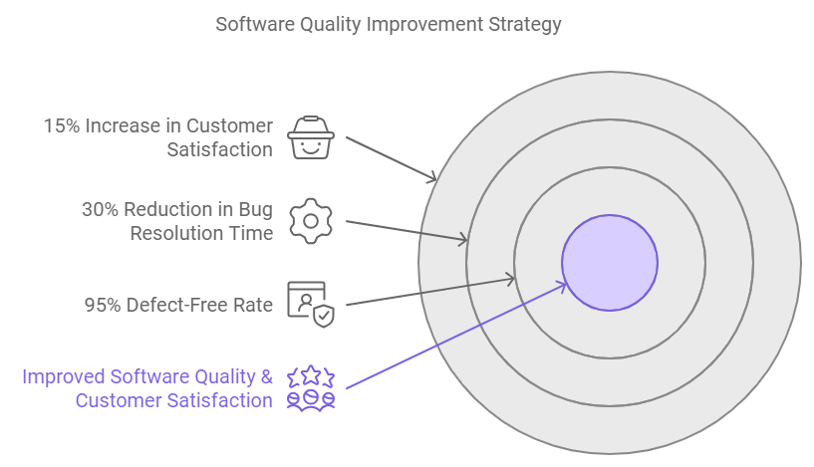
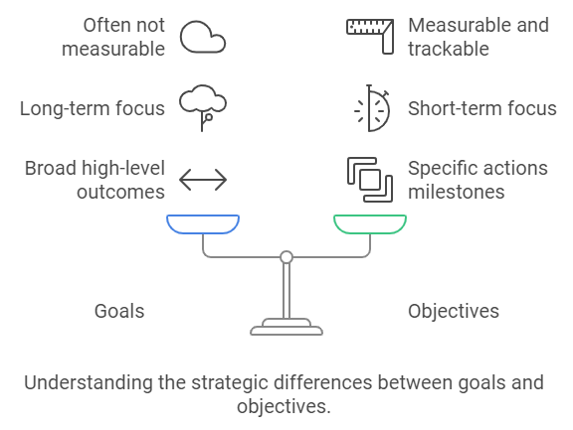
Goals vs Objective

Slide 20
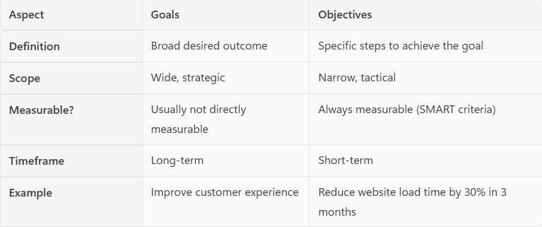

Slide 21
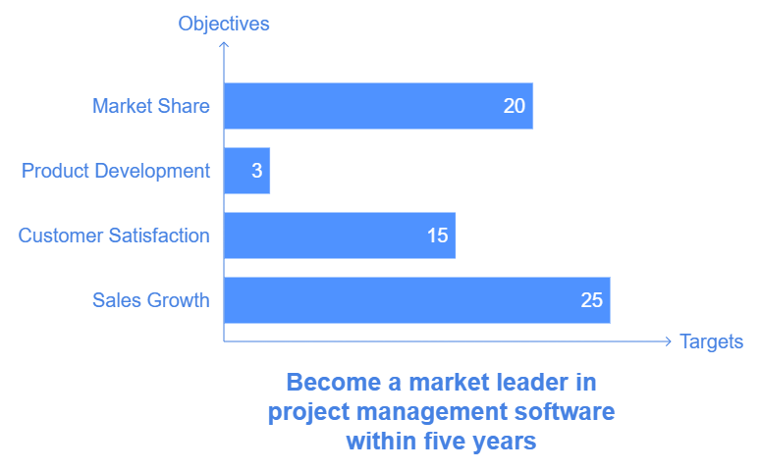

Slide 22
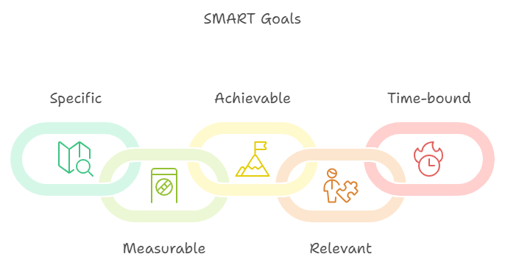
SMART Goals

Slide 23
SMART Goals
Goal: "Reduce production defects by 20% in the next six months by implementing stricter quality control checks and employee training programs."
  Specific: Targets defect reduction.
  Measurable: Goal is a 20% reduction.
  Achievable: Feasible through quality control and training.
  Relevant: Important for maintaining high product quality.
  Time-bound: Six-month timeframe.
Goal: "Increase code coverage for all core modules from 60% to 85% by the end of Q3 by implementing automated testing practices and code reviews."
  Specific: Focuses on improving code coverage.
  Measurable: Target is 85% coverage.
  Achievable: Attainable with resources and planned automation.
  Relevant: Aligns with the team’s objective of improving software quality.
  Time-bound: Set for completion by the end of Q3.

Slide 24
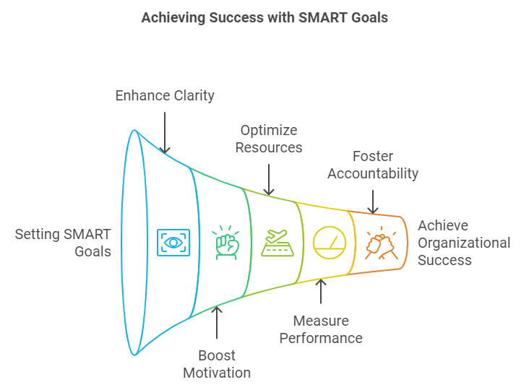
Benefits :SMART Goals
Benefits of SMART Goals
  Clarity and Focus: SMART goals eliminate ambiguity, allowing teams to focus on concrete objectives.
  Improved Motivation: Specific and achievable goals encourage motivation and commitment.
  Better Resource Allocation: Knowing what is required helps in resource planning and avoiding wastage.
  Enhanced Performance Measurement: SMART goals allow tracking progress, making it easier to adjust efforts as needed.
  Greater Accountability: Time-bound goals encourage responsibility and foster accountability.

Slide 25
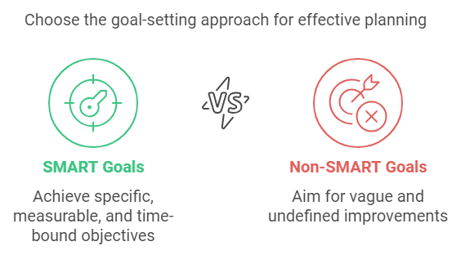
SMART vs NON-SMART
SMART Goal: "Increase website traffic by 25% in the next three months by publishing two SEO-optimized blog posts per week and promoting them on social media channels."
  Non-SMART Goal: "Get more website visitors.
SMART Goal: "Complete the development of the new mobile app feature by March 30th, including thorough testing and code review to ensure a smooth release."
  Non-SMART Goal: "Finish the mobile app update soon."
SMART Goal: "Improve customer satisfaction score from 80% to 90% over the next six months by implementing a new customer feedback process and resolving reported issues within 48 hours."
  Non-SMART Goal: "Make customers happier."
SMART Goal: "Reduce product defects by 15% in the next quarter by enhancing quality control measures and conducting weekly training sessions for the production team."
  Non-SMART Goal: "Make production quality better."
SMART Goal: "Increase sales revenue by 10% by the end of Q4 through targeted email marketing campaigns and upselling to existing customers."
  Non-SMART Goal: "Boost sales."

Slide 26
Project Program Portfolio & System
Project
A temporary endeavor undertaken to create a unique product, service, or result.
Key Features:
  Has a start and end date
  Delivers a specific output
  Managed within scope, time, cost, and quality constraints
Examples:
  Engineering College: Constructing a new laboratory building.
  Software Company: Developing a mobile banking app.

Slide 27
Project Program Portfolio & System
Program
A collection of related projects managed together to achieve strategic benefits.
Key Features:
  Projects are interdependent
  Focus on benefits realization
Examples:
  Engineering College: Campus Expansion Program → includes projects like:
    New lab construction
    Hostel building
    Smart classroom setup
  Software Company: Digital Transformation Program → includes:
    Cloud migration
    Mobile app development
    Cybersecurity upgrade

Slide 28
Project Program Portfolio & System
Portfolio
A collection of programs, projects, and operations managed as a group to achieve organizational strategy.
Key Features:
  Aligns with business objectives
  Focus on value delivery
Examples:
  Engineering College: Academic Development Portfolio → includes:
    Campus Expansion Program
    Research & Innovation Program
    Student Placement Program
  Software Company: IT Portfolio → includes:
    Digital Transformation Program
    Data Analytics Program
    Infrastructure Upgrade Project

Slide 29
Project program portfolio system
Project: A project is a temporary endeavor with a specific goal, such as creating a unique product, service, or result. Projects have defined start and end dates and are managed to achieve particular objectives within constraints like time, budget, and resources¹.
Program: A program is a collection of related projects managed in a coordinated way to obtain benefits and control not available from managing them individually. Programs focus on achieving strategic objectives and delivering outcomes that contribute to the organization’s goals¹.
Portfolio: A portfolio consists of a group of programs and projects that are managed together to achieve strategic business objectives. Portfolio management involves selecting and prioritizing projects and programs to ensure they align with the organization’s strategic goals and optimize resource use¹.
System: In the context of project management, a system refers to the set of processes, tools, and methodologies used to manage projects, programs, and portfolios. It encompasses the frameworks and standards that guide project management practices and ensure consistency and efficiency across the organization
Sure! Here are examples of a project, program, portfolio, and system in a software company:
Project: Developing a new mobile application for customer service. This project has a specific goal, timeline, and budget, and aims to create a unique product to enhance customer interactions.
Program: A digital transformation program that includes multiple related projects such as:
  Developing the new mobile application.
  Upgrading the company’s website.
  Implementing a new Customer Relationship Management (CRM) system. These projects are managed together to achieve the broader goal of improving digital customer experiences.
Portfolio: The company’s innovation portfolio, which includes various programs and projects aimed at driving technological advancements and business growth. This portfolio might consist of:
  The digital transformation program.
  Research and development projects for new software products.
  Initiatives to improve internal IT infrastructure. Portfolio management ensures these efforts align with the company’s strategic objectives and optimizes resource allocation.
System: The project management system used by the company, which includes tools and methodologies like Agile, Scrum, or Kanban. This system provides the framework for managing projects, programs, and portfolios, ensuring consistency, efficiency, and alignment with the company’s goals.

Slide 30
Aspect | Project | Program | Portfolio
Scope | Specific deliverable or outcome | Multiple related projects | Multiple programs and/or projects
Objective | Unique, defined end-product | Strategic benefit through synergy | Align with organizational strategy
Duration | Temporary | Often longer-term, until objectives met | Ongoing or adjusted over time
Structure | Managed by a project manager | Managed by a program manager | Managed by a portfolio manager
Example | Developing a new software application | Customer experience improvement program | Technology innovation portfolio

Slide 31
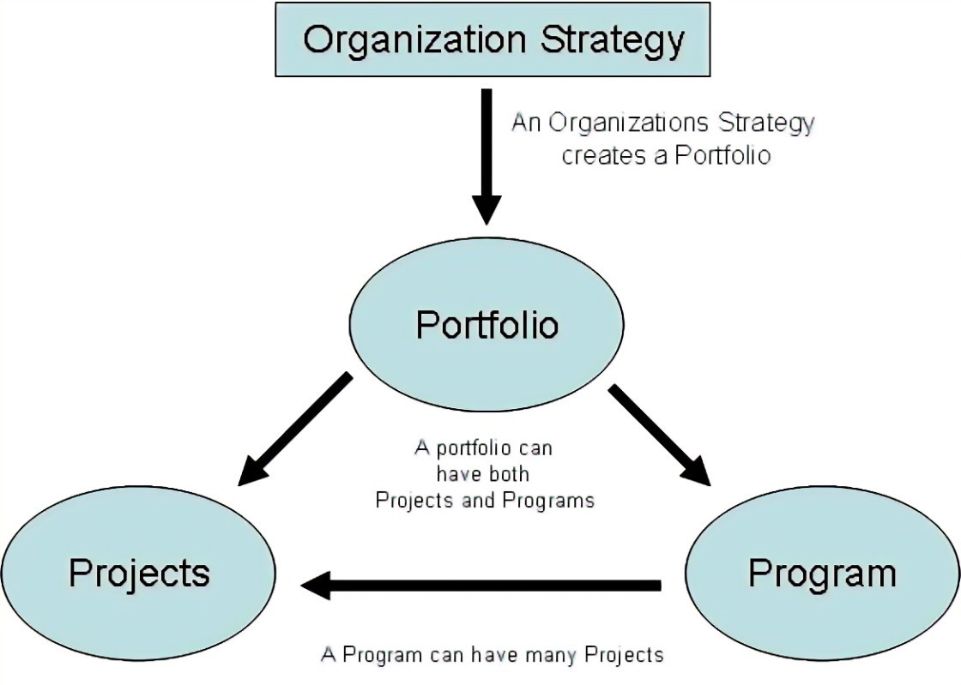
Example
Imagine a software company aiming to improve its market position:
Project: Develop a new AI-based feature for their project management software.
Program: A program to enhance user experience across all software products, including projects like the AI feature, UI redesign, and customer feedback integration.
Portfolio: The company’s entire set of initiatives, including the user experience program, new product development, and market expansion efforts.
System: The IT infrastructure and software tools that support the development, testing, and deployment of all these projects and programs.

Slide 32
Project Types
By Project Life Cycle
  Predictive (Waterfall): Projects with well-defined requirements and scope, such as construction projects.
  Iterative: Projects that evolve through repeated cycles, like software development with regular updates.
  Incremental: Projects delivered in small, usable segments, such as phased rollouts of a new software feature.
  Agile: Projects that adapt to changes quickly, often used in software development.
  Hybrid: A combination of predictive and agile approaches, suitable for complex projects with both stable and evolving elements.
By Application Area
  Construction: Building infrastructure like bridges or buildings.
  IT and Software Development: Creating or upgrading software applications.
  Healthcare: Implementing new healthcare systems or medical devices.
  Marketing: Launching new marketing campaigns or branding initiatives.
By Complexity
  Simple Projects: Projects with straightforward objectives and few dependencies, such as updating a website.
  Moderately Complex Projects: Projects with multiple stakeholders and interdependencies, like developing a new software module.
  Highly Complex Projects: Projects with high uncertainty and numerous interdependencies, such as launching a new product line.

Slide 33
Project Types
By Strategic Importance
  Operational Projects: Focused on improving current operations, like process optimization.
  Strategic Projects: Aligned with long-term goals, such as entering a new market.
  Compliance Projects: Ensuring adherence to regulations, like implementing GDPR compliance.
By Resource Requirements
  Capital Projects: Require significant financial investment, such as building a new data center.
  Operational Projects: Utilize existing resources and focus on efficiency, like upgrading software systems.
By Duration
  Short-term Projects: Completed within a few months, such as a marketing campaign.
  Medium-term Projects: Lasting several months to a year, like developing a new software application.
  Long-term Projects: Spanning multiple years, such as large infrastructure projects.

Slide 34
Project Types
By Strategic Importance
  Operational Projects: Focused on improving current operations, like process optimization.
  Strategic Projects: Aligned with long-term goals, such as entering a new market.
  Compliance Projects: Ensuring adherence to regulations, like implementing GDPR compliance.
By Resource Requirements
  Capital Projects: Require significant financial investment, such as building a new data center.
  Operational Projects: Utilize existing resources and focus on efficiency, like upgrading software systems.
By Duration
  Short-term Projects: Completed within a few months, such as a marketing campaign.
  Medium-term Projects: Lasting several months to a year, like developing a new software application.
  Long-term Projects: Spanning multiple years, such as large infrastructure projects.

Slide 35
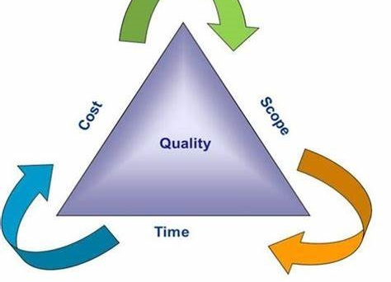
Project Constraints
Project constraints are the limitations that define the boundaries within which a project must operate. These constraints are crucial for project planning, execution, and control. The primary constraints are often referred to as the Triple Constraint or Iron Triangle, which includes.
Scope
Definition: The work required to deliver a product, service, or result with the specified features and functions. What needs to be delivered (features, functionality).
Impact: Changes in scope can affect the project’s cost and schedule.
Example: Adding new features to a software project increases the scope.
Example: A software development project must deliver a mobile app with 10 core features. Adding extra features without adjusting time or cost creates scope creep.
Time
Definition: The schedule for completing the project, including deadlines for each phase and the final delivery. Specifies the deadline or schedule for completing the project.
Impact: Delays can increase costs and affect the quality of the deliverables.
Example: A project to develop a new software application must be completed in six months.
Example: A construction project must finish before the monsoon season starts. Any delay could increase costs and risks.
Cost
Definition: The budget allocated for the project, including all resources required. Limits the financial resources available.
Impact: Budget overruns can lead to project failure or require additional funding.
Example: The total budget for developing a new software application is $500,000. Example: A marketing campaign has a budget of $50,000. If costs exceed this, the project may need to reduce scope or extend timelines.

Slide 36
Additional Constraints
Quality
  Definition: Ensures software deliverables meet defined standards (e.g., coding standards, performance benchmarks, security compliance).
  Impact: Compromising on quality can lead to stakeholder dissatisfaction and rework.
  Example: A team is building a mobile app. If they skip proper testing to meet a launch date, the app crashes frequently. This fails quality standards and frustrates users.
Risk
  Definition: Potential events that could impact the project positively or negatively.
  Impact: Risks need to be managed to minimize their impact on the project.
  Example: A software project depends on a third-party API for payment processing. If the API provider changes pricing or service terms unexpectedly, the project may face cost overruns or require redesigning the payment module.
Resources
  Definition: Availability of skilled personnel, tools, and infrastructure.
  Impact: Resource constraints can delay the project and increase costs.
  Example: A software company is building a microservices architecture but has only one Kubernetes expert available for 10 hours per week. This slows down container orchestration and delays deployment, even if other teams are ready.
Customer Satisfaction
  Definition: The value or benefits that the project is expected to deliver.
  Impact: Projects must deliver sufficient benefits to justify the investment.
  Example: The software project is expected to increase productivity by 20%.

Slide 37
Managing Constraints
Effective project management involves balancing these constraints to achieve project success. Here are some strategies:
Prioritize Constraints: Determine which constraints are most critical and focus on managing them.
Monitor and Control: Regularly track project performance against the constraints and make adjustments as needed.
Stakeholder Communication: Keep stakeholders informed about constraints and any changes to them.
Risk Management: Identify, assess, and mitigate risks that could impact the constraints.

Slide 38
Advantages of Project Management
Clear Objectives:
  Defines goals and deliverables.
  Example: A PM sets a target to complete software development in 3 months.
Better Resource Management:
  Ensures optimal use of resources (human, financial, technical).
  Example: Allocating developers to high-priority features.
Risk Mitigation:
  Identifies potential risks and plans mitigations.
  Example: Creating backup plans for data loss during app testing.
Improved Communication:
  Enhances collaboration and stakeholder engagement.
  Example: Weekly meetings to review progress.
Enhanced Quality:
  Focuses on meeting standards and delivering value.
  Example: Quality assurance processes to ensure app reliability.

Slide 39
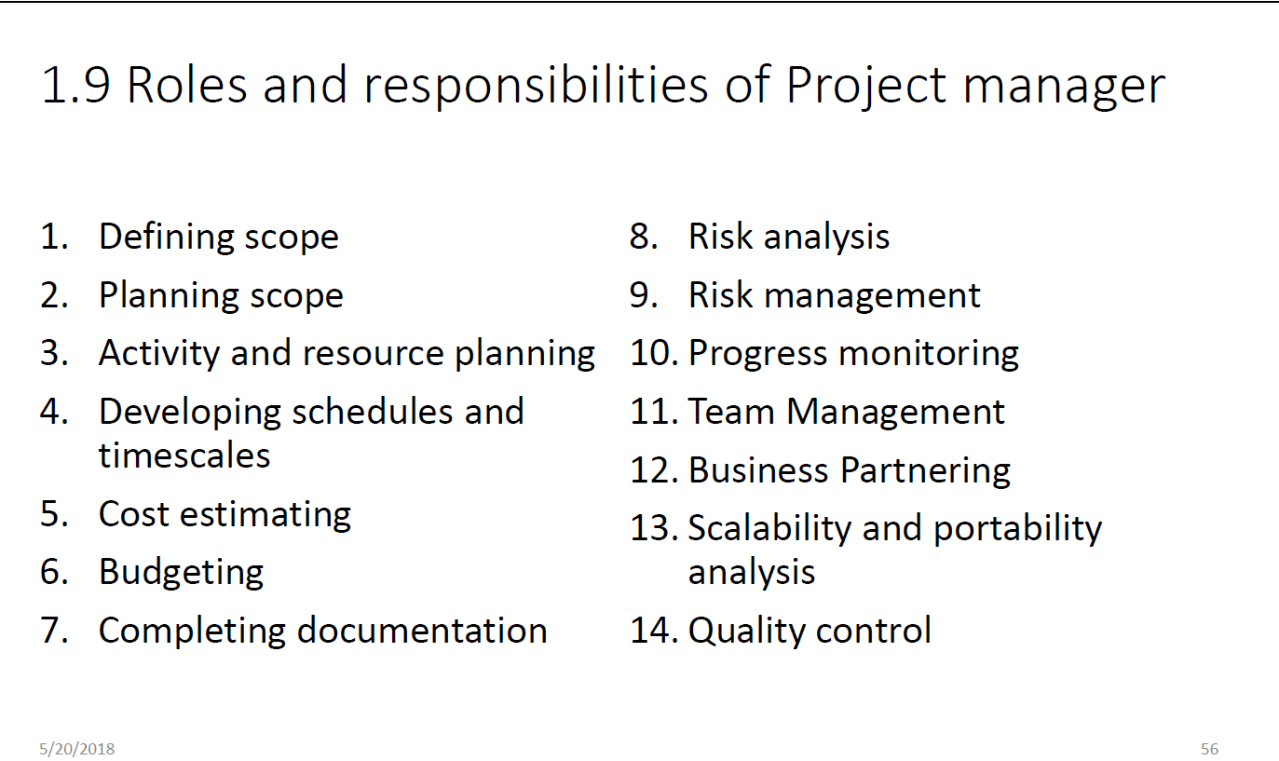

Slide 40
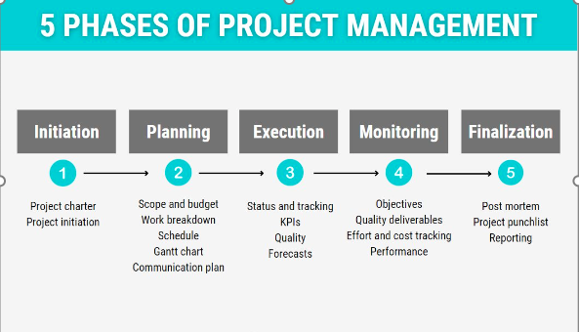
Project Management
Project management is the application of knowledge, skills, tools, and techniques to project activities to meet project requirements. It involves several key processes and phases, including:
Initiation: Defining the project and obtaining authorization.
Planning: Establishing the scope, objectives, and procedures.
Execution: Coordinating people and resources to carry out the plan.
Monitoring and Controlling: Tracking, reviewing, and regulating progress and performance.
Closing: Finalizing all activities to formally close the project.

Slide 41
Initiation
Initiation Phase
  Purpose: Define the project at a high level and secure authorization to proceed.
Inputs:
  Project Charter Template: Outlines goals, stakeholders, and constraints.
  Business Case: Justifies the project and its value.
  Stakeholder Register: Identifies key stakeholders and their interests.
  Enterprise Environmental Factors (EEFs): External factors like industry standards or market conditions.
  Organizational Process Assets (OPAs): Templates, lessons learned from past projects.

Slide 42
Initiation
Processes:
  Develop Project Charter.
  Identify Stakeholders.
Outputs:
  Project Charter: Document authorizing the project, containing objectives and key requirements.
  Stakeholder Register: List of stakeholders, their roles, and engagement levels.
Example:
  A company wants to develop a mobile app for e-commerce.
  Input: Market analysis report, proposal.
  Output: Approved Project Charter with the app's scope (e.g., features like user login, payment integration).

Slide 43
Planning
Purpose: Create a roadmap to achieve the project goals.
Inputs:
  Project Charter: Provides high-level project details.
  Stakeholder Register: Guides stakeholder engagement plans.
  Requirements Documentation: Details of stakeholder needs.
  Risk Register: Identified risks to be mitigated.
Processes:
  Define Scope.
  Develop Project Management Plan.
  Plan Resources, Budget, Schedule, and Risks.
  WBS: Break down the software development process into tasks like design, coding, testing, and deployment.

Slide 44
Planning
Outputs:
  Project Management Plan: Comprehensive plan covering scope, schedule, cost, quality, communication, and risk.
  Baseline Plans: Approved versions of scope, schedule, and budget.
  Risk Management Plan: Strategy for handling risks.
  Resource Plan: Allocation of team and tools.
Example:
  For the mobile app, the plan includes timelines for design (2 months), development (3 months), and testing (1 month).
Input: User requirements, team skills.
Output: Gantt chart, risk matrix, and project plan.

Slide 45
Execution
Purpose: Implement the project plan to produce deliverables.
Inputs:
  Project Management Plan: Guides execution.
  Approved Change Requests: Reflect any modifications.
  Project Documents: Scope, schedules, and contracts.
  Resource Assignments: Allocated team and tools.
Processes:
  Manage Project Work.
  Acquire Resources.
  Execute Communication and Quality Plans.

Slide 46
Execution
Outputs:
  Deliverables: Tangible or intangible outputs (e.g., app prototype).
  Issue Log: Tracks problems during execution.
  Performance Reports: Metrics on progress, quality, and cost.
  Updated Project Plan: Reflecting ongoing changes.
Example:
  Developing the e-commerce app:
Input: Project management plan, resource assignments.
Output: Functional app prototype, progress reports.

Slide 47
Monitoring and Control
Outputs:
  Deliverables: Tangible or intangible outputs (e.g., app prototype).
  Issue Log: Tracks problems during execution.
  Performance Reports: Metrics on progress, quality, and cost.
  Updated Project Plan: Reflecting ongoing changes.
Example:
  Developing the e-commerce app:
Input: Project management plan, resource assignments.
Output: Functional app prototype, progress reports.

Slide 48
Monitoring and Control
Outputs:
  Work Performance Reports: Consolidated progress data.
  Change Requests: Approved modifications to the plan.
  Corrective Actions: To address deviations.
  Updated Documents: Logs, risk register, and plan.
Example:
  If testing the app shows issues with payment integration, monitoring identifies delays, and corrective actions are taken to allocate more developers to fix the problem.
Input: Test reports, Gantt chart.
Output: Updated timeline, change request approval.

Slide 49
Closing
Purpose: Finalize the project and hand over deliverables.
Inputs:
  Project Management Plan: For closure requirements.
  Accepted Deliverables: From quality checks.
  OPAs: Closure guidelines and templates.
Processes:
Close Project or Phase.
Finalize all Activities.

Slide 50
Closing
Outputs:
  Final Product/Service: Handover of the deliverable.
  Lessons Learned Register: Record of what worked and what didn’t.
  Final Report: Summary of project performance.
  Archived Documents: For future reference.
Example:
  The mobile app is deployed to app stores.
Input: Testing reports, approved deliverables.
Output: Delivered app, project closure report, feedback.

Slide 51
Project Charter
A Project Charter is a formal document that authorizes the project and provides a high-level overview of the project objectives, key stakeholders, and resources. It serves as the foundational reference document.
Key Components:
  Objectives: What the project aims to achieve.
  Scope: High-level deliverables.
  Stakeholders: Key individuals or groups.
  Constraints: Time, budget, resources.
Example:
  Project: Development of an E-commerce Platform.
Charter Highlights:
  Objective: Build a mobile-friendly e-commerce platform within six months.
  Sponsor: CEO of the company.
  Budget: $500,000.
  Milestones: Design (1 month), Development (3 months), Testing (1 month).

Slide 52
Project Charter
A project charter is an official document that outlines the objectives, scope, and participants of a project. It serves as a preliminary delineation of roles and responsibilities, identifies the main stakeholders, and defines the authority of the project manager.
Why is a Project Charter Needed?
A project charter is crucial because it:
Authorizes the Project: It formally initiates the project and grants the project manager the authority to use organizational resources.
Defines Objectives and Scope: It clearly outlines what the project aims to achieve and the boundaries within which it will operate, helping to prevent scope creep.
Aligns Stakeholders: It ensures that all stakeholders have a shared understanding of the project’s goals, scope, and deliverables.
Provides a High-Level Plan: It offers a broad overview of the project, including timelines, key milestones, and potential risk

Slide 53
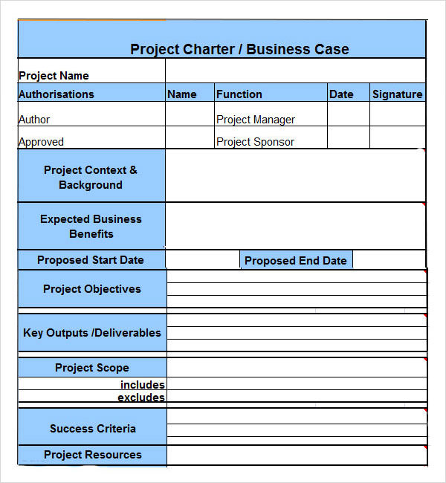
Project Charter

Slide 54
Stakeholder Register
A Stakeholder Register is a document that identifies all stakeholders involved in the project, their roles, and their influence or interest in the project.
Key Components:
  Stakeholder Name.
  Role/Responsibility.
  Influence Level (High, Medium, Low).
  Engagement Strategy.
Types:
Internal Stakeholders: Project team, managers, or executives.
External Stakeholders: Clients, vendors, regulatory agencies.

Slide 55
Stakeholder Register
Example:
Name | Role | Influence | Engagement Strategy
John Smith | Project Sponsor | High | Weekly progress reports
Jane Doe | Client | High | Bi-weekly updates
Sarah Johnson | QA Lead | Medium | Daily sync meetings

Slide 56
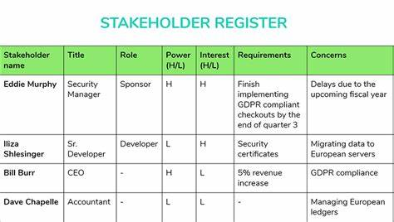
Stakeholder Register

Slide 57
EEF
EEFs are external or internal factors that influence a project's success but are outside the project manager's control.
Types:
Internal EEFs:
  Organizational structure.
  Company culture.
  Resource availability.
External EEFs:
  Market conditions.
  Regulatory requirements.
  Technological advancements.
Example:
Internal EEF: Limited skilled resources due to hiring freeze.
External EEF: A new data privacy law affecting app design.

Slide 58
EEF
Enterprise Environmental Factors (EEF)
  EEF are external and internal factors that impact a project's success but are not under the control of the project team. These factors can include:
  External EEF: Government regulations, market conditions, industry standards, and legal restrictions.
  Internal EEF: Organizational culture, infrastructure, available resources, and internal political conditions.
Example of EEF: If a project is being executed in a country with strict environmental regulations, these regulations would be considered an EEF. The project team must comply with these regulations, which could affect project timelines and costs

Slide 59
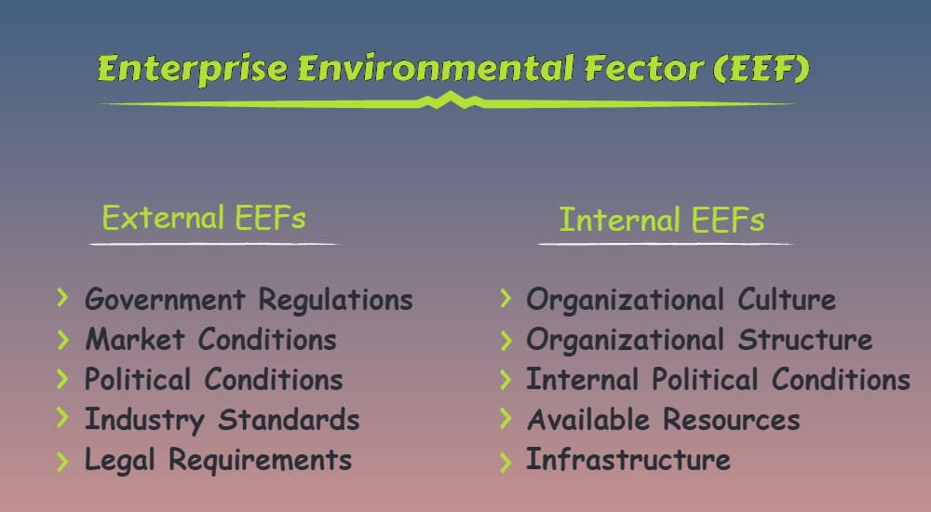
EEF

Slide 60
OPA
OPAs are resources and tools within an organization that help manage projects. These include templates, processes, policies, and historical data.
Types:
Processes and Procedures:
  Risk management procedures.
  Quality assurance policies.
Knowledge Repositories:
  Lessons learned.
  Historical project data.
Example:
OPA Resource: A risk management template from a previous project.
Knowledge Repository: Lessons learned from a past app development project.

Slide 61
OPA
Organizational Process Assets (OPA)
  OPA are internal to the organization and include any processes, policies, procedures, and knowledge bases that the organization uses to manage projects. These assets help ensure consistency and efficiency in project execution.
OPA can be divided into two main categories:
  Processes, Policies, and Procedures: These include project initiation processes, risk management policies, and change control procedures.
  Organizational Knowledge Bases: These are repositories of historical information, lessons learned, and project documentation.
Example of OPA: A company might have a standardized project management template that all project managers use to create their project plans. This template ensures that all projects follow a consistent format and include all necessary information

Slide 62
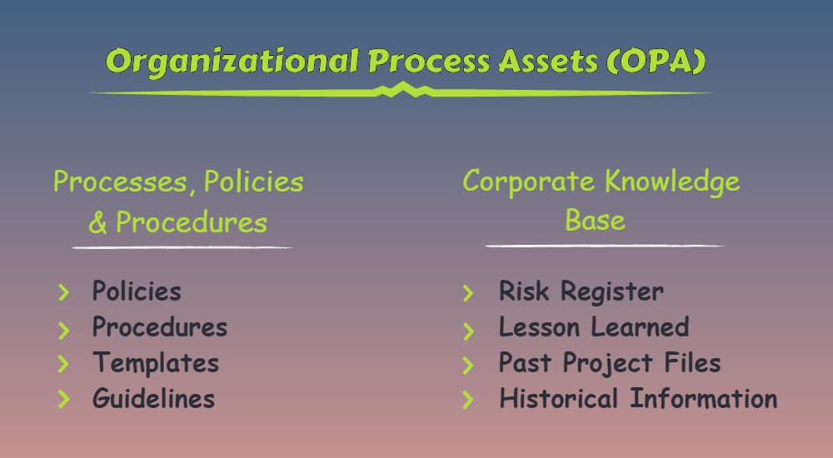
OPA

Slide 63
Risk Register
A Risk Register is a document that lists all identified risks, their potential impacts, and mitigation strategies.
Key Components:
  Risk Description.
  Likelihood: Probability of occurrence.
  Impact: Severity on the project.
  Owner: Person responsible for managing the risk.
  Mitigation Plan: Actions to reduce risk.
Types:
Project Risks:
  Technical Risks: Technology not performing as expected.
  Schedule Risks: Delays in key milestones.
Operational Risks:
  Resource Risks: Unavailability of key team members.
  Budget Risks: Cost overruns.
External Risks:
  Regulatory Risks: Compliance with new laws.
  Environmental Risks: Natural disasters.

Slide 64
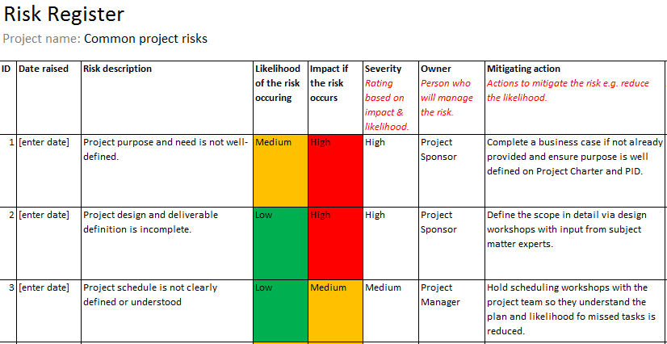
Risk Register

Slide 65
Risk Register
Example:
Risk | Likelihood | Impact | Owner | Mitigation Plan
Payment gateway failure | High | High | Tech Lead | Test backup gateways in advance
Developer availability | Medium | Medium | PM | Cross-train team members
Data privacy compliance | High | High | Legal Team | Regular audits and reviews

Slide 66
Summary
Term | Definition | Example
Project Charter | High-level document that authorizes the project. | Charter for developing a new app with objectives and budget.
Stakeholder Register | List of stakeholders, their roles, and strategies to manage them. | A table identifying the CEO, project team, and client as stakeholders with respective influence levels.
EEF | External and internal factors influencing the project. | Regulatory laws affecting app compliance, company culture, or resource availability.
OPA | Organizational resources like templates, processes, and lessons learned. | Risk management template from a previous project or a knowledge base for troubleshooting issues.
Risk Register | Document listing risks, their likelihood, impact, and mitigation strategies. | Risk of delayed project delivery due to team shortage, with a cross-training plan as mitigation.

Slide 67
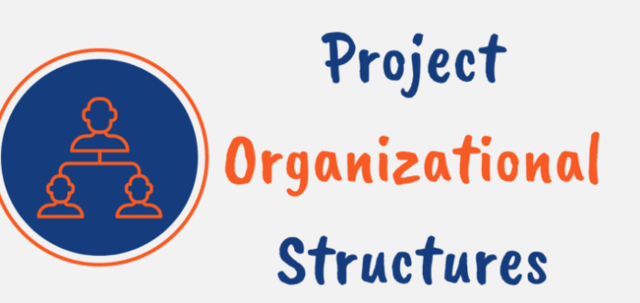
Organizational Structure
For a company, choosing the right organizational structure is crucial for project success.
And for a project manager, the organizational structure of the company you are working with largely determines your authority and how you manage projects.
Most companies use either a functional, matrix, or projectized organizational structure. Each has strengths and weaknesses depending on factors like company size, industry, and objectives.
Organizational structure defines how activities such as task allocation, coordination, and supervision are directed toward achieving organizational goals. It establishes reporting relationships, authority levels, and communication channels within an organization.

Slide 68
Organizational Structure
The organizational structure defines how a company arranges its staff to achieve its objectives.
It establishes lines of authority and communication, allocates resources, and affects many aspects of business operations, including workflow, resource utilization, and project outcomes.
An organization’s structure directly impacts project success in a ton of ways. It determines:
  How project resources are allocated
  The level of authority granted to project managers
  Efficiency of decision-making and governance
  Collaboration and information flow
  Project budget oversight and spending

Slide 69
Why it is important?
Clarifies Roles & Responsibilities: Ensures everyone knows their duties.
Defines Authority & Decision-Making: Who approves what, reducing confusion.
Improves Communication: Clear reporting lines streamline information flow.
Impacts Project Management: Determines resource availability, project manager authority, and stakeholder engagement.
Influences Organizational Culture: Shapes collaboration and innovation.

Slide 70
Types of Organization
Basis for Categorizing Organizations
Organizations are categorized based on several factors:
  Authority Distribution: How authority and decision-making power are distributed (e.g., centralized vs. decentralized).
  Project Management Needs: The extent to which projects drive the organization’s operations.
  Resource Allocation: How resources are allocated and managed across different functions and projects.
  Operational Focus: Whether the focus is on functional efficiency or project outcomes.

Slide 71
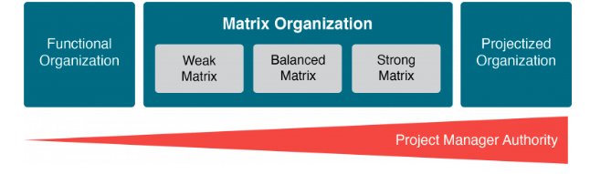

Slide 72
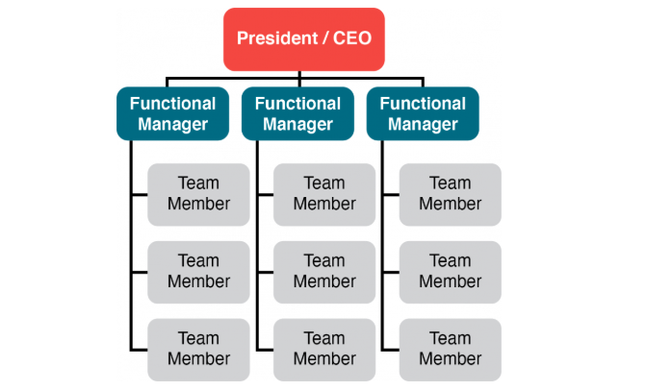
Functional Organization
A functional organization is a structure where the company is divided into departments based on functions (e.g., IT, HR, Finance, Marketing). Each department is managed by a functional manager, and employees report primarily to that manager.
In this structure:
  Authority lies with functional managers.
  Project managers have little or no authority; they act as coordinators or expediters.
  Resources are controlled by functional departments.
Example: A company where the marketing team reports to the Marketing Manager, and the finance team reports to the Finance Manager.

Slide 73
Functional Organization
In a functional organization, the company is divided into different functional areas, such as IT, finance, marketing, sales, HR, etc.
It has tall hierarchies with narrow spans of control and communication moves vertically within siloed units.
Each department works independently and is led by a department manager who reports to the top management.
In this type of setup, projects are usually managed within the functional unit and project resources are likely to report to their functional manager who has the highest authority and decision-making power.
This structure is common in organizations where projects often serve the ongoing operations of the company.
Functional structures promote specialization as employees build expertise in their field by repeating similar tasks with their focus aligned with their department’s singular purpose.

Slide 74
Functional Organization
Pros
  Specialization: Deep expertise within departments.
  Clear Hierarchy: Well-defined roles and responsibilities.
  Efficiency: Resources are used effectively within functional areas.
  Career Growth: Employees develop strong functional skills.
Cons
  Limited Project Focus: Projects are secondary to departmental goals.
  Slow Decision-Making: Cross-department coordination can be cumbersome.
  Low Project Manager Authority: PM cannot directly control resources.
  Communication Barriers: Silos between departments.

Slide 75
When functional?
When operations are stable and predictable.
When projects are small or internal, requiring minimal cross-functional collaboration.
When specialized expertise is critical and projects do not need rapid execution.
Common in organizations focused on efficiency and specialization rather than innovation.
PMBOK Perspective
  Project Manager Role: Acts as a coordinator or expeditor.
  Authority Level: Low.
  Resource Availability: Controlled by functional managers.
  Budget Control: Functional manager owns the budget.

Slide 76
Advantages and Disadvantages of Functional
Functional organizations have these key advantages:
  Promotes skill development within functions
  Achieves efficiencies from repetitive work
  Clear structure with a single chain of command
  Simpler coordination within functions
  Functional managers control resources and budgets
Conversely, functional models present these disadvantages:
  Communication limited across functional silos
  Delayed responses to change
  Limited collaboration across departments
  Resource duplication across units
  Constrained overview of organizational objectives
  Project managers have little to no real authority

Slide 77
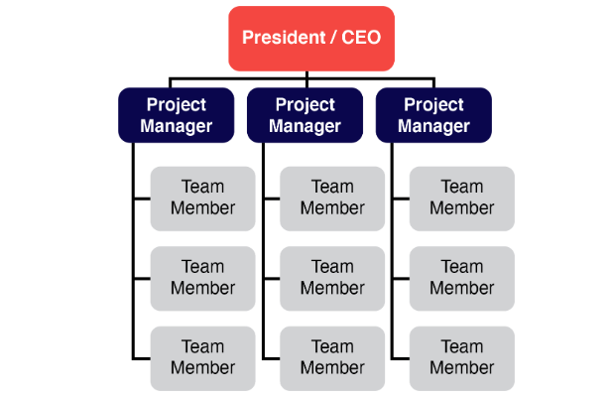
Projectized Organization
Projectized Organization:
A projectized organization is structured around projects rather than functional departments. In this model:
Project Managers have full authority over the project.
Resources are dedicated to projects and report directly to the Project Manager.
Functional departments may exist but play a minimal role.

Slide 78
Projectized Organization
In a projectized organization, the organization is structured around projects. That means the team is assembled to complete a project.
In projectized models, the project manager has complete authority over the project. They make resource allocation decisions and manage the budget while the project team focuses solely on their project with no competing priorities.
Once projects end, resources are reassigned to new teams. Projectized organizations maintain a small support staff to handle functions like legal, HR, and facilities. However, most employees are dedicated to project work.
This structure is common in consultancies, construction, and other fields where a team comes together to accomplish a defined project and then moves on to different projects.

Slide 79
When Projectized?
Specific situations where projectized models excel include:
  Organizations with primarily project-based work
  Businesses that change objectives frequently
  Short-term projects with a defined lifespan
  Environments with many unique deliverables
  Companies requiring cross-functional collaboration

Slide 80
Projectized Organization
Pros
  High Project Focus: All efforts are directed toward project success.
  Clear Authority: PM has full control over resources and decisions.
  Fast Decision-Making: No dependency on functional managers.
  Strong Team Cohesion: Team members are fully dedicated to the project.
Cons
  Resource Duplication: Multiple projects may require similar resources.
  Uncertainty for Employees: After project completion, roles may end.
  Higher Cost: Dedicated resources increase overhead.
  Limited Knowledge Sharing: Expertise may not transfer across projects easily.

Slide 81
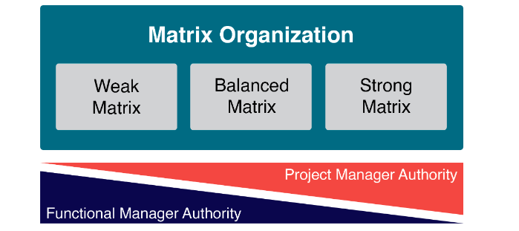
Matrix
Matrix Organization:
  A Matrix Organization blends elements of Functional and Projectized structures. Employees report to two managers:
  A Functional Manager (department head)
  A Project Manager (responsible for the project)
This structure aims to balance specialization (functional) and project focus.
  Types:
    Strong Matrix: Project managers have more authority.
    Weak Matrix: Functional managers have more authority.
    Balanced Matrix: Authority is shared equally.
  Example: A tech company where software developers report to both the Head of Development and the Project Manager for specific projects.

Slide 82
Matrix
The matrix structure is a blend of functional and projectized structures. In a matrix organization, team members report to both a functional manager and one or more project managers.
Communication flows vertically and horizontally in this organizational structure as employees collaborate and share knowledge across functions and teams.
Since the team members basically report to more than 1 manager, the amount of authority divided between the two managers defines the type of matrix.
The weak matrix resembles functional structures where project managers act as coordinators with limited power while the strong matrix has features of projectized models with empowered project managers.
There are 3 types of matrix organizational structures:
  Weak Matrix: The functional manager has the prime authority
  Balanced Matrix: The authority shared equally
  Strong Matrix: The project manager has the prime authority

Slide 83
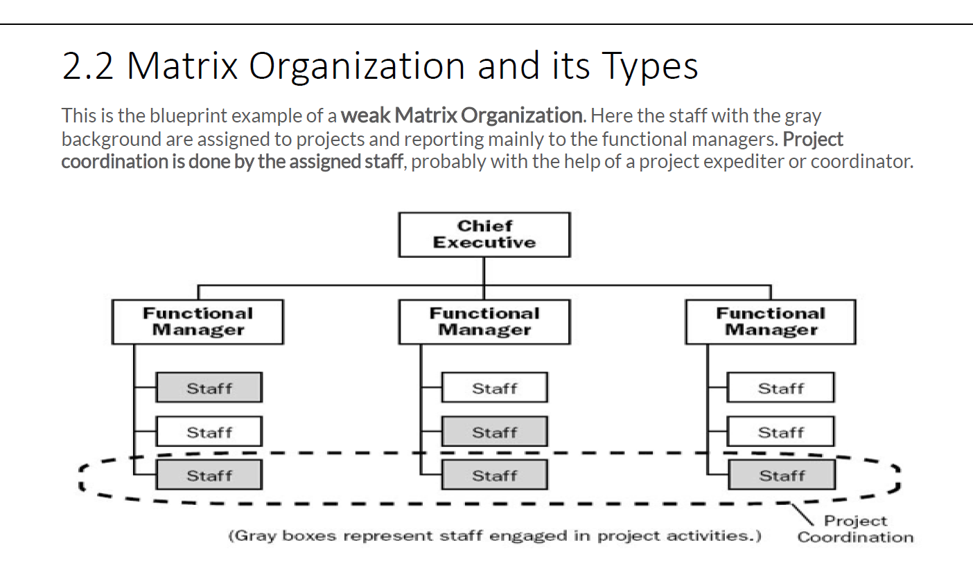

Slide 84
Weak Matrix
PMBOK defines three types based on the authority level of the Project Manager:
Weak Matrix
Authority: Functional Manager dominates; PM acts as a coordinator or expeditor.
Example: A software company where developers primarily report to their department head, and PM only facilitates tasks.
Pros:
  Maintains strong functional expertise.
  Clear career paths within departments.
Cons:
  PM has little control over resources.
  Slow decision-making.
When to Use:
  When projects are small and functional priorities dominate.

Slide 85
Balanced Matrix
Authority: Shared between PM and Functional Manager.
Example: A product development company where PM and department head jointly allocate resources.
Pros:
  Good balance between project and functional needs.
  Encourages collaboration.
Cons:
  Dual authority can cause conflicts.
  Complex communication.
When to Use:
  When projects require significant cross-functional collaboration.

Slide 86
Strong Matrix
Authority: PM has more authority than Functional Manager (similar to Projectized).
Example: A large IT services firm where PM controls budget and resources, but functional managers provide technical expertise.
Pros:
  Strong project focus.
  Faster decision-making.
Cons:
  Functional managers may feel sidelined.
  Resource conflicts possible.
When to Use:
  When projects are critical and need strong leadership.

Slide 87
When Matrix?
Specific situations where a matrix structure may be best include:
  Organizations requiring cross-functional collaboration
  Businesses needing to quickly reprioritize resources
  Large or complex projects requiring multiple skillsets
  Companies with high volumes of varied projects
  Dynamic industries needing responsiveness to change

Slide 88
Matrix Organization
Here are some key advantages of matrix organizations:
  Flexibility to deploy resources across functions and projects
  Ability to prioritize needs and share talent
  Promotes cross-functional communication and collaboration
  Project-specific focus while maintaining functional skills
Conversely, here are some drawbacks of matrix organizational structures:
  Complex dual reporting relationships
  Role confusion from multiple managers
  Power struggles between functional and project managers
  Resource conflict across departments and projects
  Lack of ownership and accountability

Slide 89
Aspect | Functional Structure | Matrix Structure | Projectized Structure
Definition | Organized by functional areas such as development, testing, marketing, etc. | Combines functional and project structures, with employees reporting to both functional and project managers. | Organized entirely around projects, where the project manager has full authority over resources and tasks.
Key Characteristics | - Clear hierarchy within departments. | - Dual reporting lines (functional and project managers). | - Project manager is the central authority.
 | - Employees specialize in their functional expertise. | - Resources are shared across projects and functions. | - Teams are formed for specific projects and disbanded afterward.
 | - Decision-making is functional-manager centric. | - Balances functional expertise with project priorities. | - Focused on achieving project goals efficiently.
Advantages | - High specialization and efficiency within functions. | - Promotes collaboration across departments. | - High flexibility and focus on project delivery.
 | - Clear career growth within functions. | - Efficient resource utilization. | - Dedicated resources ensure quick decision-making.
Disadvantages | - Silo mentality; less collaboration between departments. | - Dual reporting can lead to conflicts and confusion. | - Limited focus on career development within specific functional areas.
 | - Slow decision-making across functions. | - Resource allocation conflicts between projects and departments. | - Resource downtime after project completion.

Slide 90
Authority | - Functional manager has full authority. | - Authority is shared between functional and project managers. | - Project manager has full authority over resources and tasks.
Team Composition | - Teams are grouped by department (e.g., development, testing). | - Teams include members from different functional areas working on the same project. | - Teams are dedicated to specific projects and consist of multidisciplinary members.
Focus | - Functional expertise and departmental goals. | - Balance between functional goals and project objectives. | - Achieving project-specific objectives.
Flexibility | - Low flexibility; changes are departmental. | - Moderate flexibility; shared resources can adapt to multiple priorities. | - High flexibility; team composition changes as projects start and end.
Examples | - IT Department: Developers report to the software development manager, QA team reports to QA lead. | - Tech Company: Developers work on multiple projects like an e-commerce app and CMS, reporting to functional and project managers. | - Consulting Firm: Teams formed for client-specific software projects, disbanded after project completion.

Slide 91
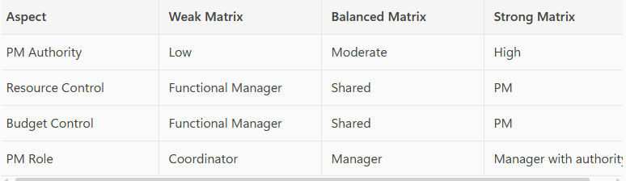
Summary
Functional: Best for organizations focusing on specialization and long-term functional goals.
Matrix: Ideal for companies managing multiple simultaneous projects while maintaining functional expertise.
Projectized: Suited for organizations heavily project-driven, like consulting firms or construction companies.

Slide 92
Project Management - Example
Example in a Software Company Context
Initiation Phase:
  Project Charter: Authorize the development of a new software feature.
  Stakeholder Analysis: Identify key stakeholders like product managers, developers, and end-users.
Planning Phase:
  WBS: Break down the software development process into tasks like design, coding, testing, and deployment.
  Risk Management Plan: Identify risks such as technical challenges or resource availability.
Execution Phase:
  Project Management Software: Use Jira to track development tasks and progress.
  Quality Assurance: Conduct regular code reviews and testing to ensure software quality.
Monitoring and Controlling Phase:
  Performance Metrics: Track the number of completed tasks and bugs fixed.
  Change Control Process: Manage any changes in software requirements or features.
Closing Phase:
  Project Closure Report: Document the outcomes of the software development project.
  Final Product Handover: Deliver the completed software feature to the product manager.

Slide 93
WBS
The Work Breakdown Structure (WBS) is a key project deliverable that organizes the team's work into manageable sections.
According to the PMBOK Guide, the WBS is a hierarchical decomposition of the total scope of work to be carried out by the project team to accomplish the project objectives and create the required deliverables.
Key Features of WBS:
  Deliverable-Oriented: The WBS focuses on deliverables rather than tasks.
  Levels of Decomposition: Work is divided into increasingly detailed levels, starting from major deliverables to smaller, manageable work packages.
  Hierarchical Representation: The structure is depicted in a tree format or tabular format.
  100% Rule: Ensures that the WBS includes all the work required for the project, with no overlap or omission.

Slide 94
WBS
Example of WBS (Building a Website)
Level 1: Project Name (Website Development)
Website Planning
  1.1 Define Objectives
  1.2 Identify Stakeholders
  1.3 Develop Requirements
Design
  2.1 Wireframes
  2.2 Mockups
  2.3 Final Design
Development
  3.1 Front-End Development
    3.1.1 HTML/CSS Structure
    3.1.2 JavaScript Functionality
  3.2 Back-End Development
    3.2.1 Database Setup
    3.2.2 API Integration

Slide 95
WBS
4. Testing and QA
  4.1 Functional Testing
  4.2 Usability Testing
  4.3 Bug Fixing
5. Deployment and Launch
  5.1 Hosting Setup
  5.2 Domain Configuration
  5.3 Go-Live

Slide 96
Benefits of WBS:
Clarifies project scope.
Facilitates resource allocation and scheduling.
Enhances risk identification and management.
Ensures comprehensive planning and control.

Slide 97
Project Team
A project team refers to a group of individuals who are responsible for performing project activities and achieving its objectives.
The composition, roles, and responsibilities of the project team vary depending on the project size, complexity, and organizational structure.

Slide 98
Project Team
Composition of the Project Team
The project team typically includes the following roles:
Role | Description
Project Manager | Responsible for leading the project, ensuring objectives are met, and balancing constraints like scope, time, and budget.
Core Team Members | Key individuals with specialized skills who contribute to project deliverables (e.g., developers, designers, analysts).
Subject Matter Experts (SMEs) | Provide expertise on specific aspects of the project (e.g., domain experts, technical specialists).
Stakeholders | May include customers, sponsors, and end-users who influence or are affected by the project.
Support Staff | Individuals providing administrative or logistical support (e.g., document controllers, coordinators).

Slide 99
Key Characteristics of a Project Team
Diversity of Skills: Team members possess the necessary expertise to perform their roles effectively.
Collaboration: Effective communication and teamwork are critical to achieve project goals.
Temporary Nature: The team is formed for the duration of the project and disbanded once objectives are met.
Adaptability: The team structure and roles may evolve based on project needs.

Slide 100
Roles and Responsibilities of the Project Team
Role | Responsibility
Project Manager | - Plan, execute, and monitor the project. - Manage the team, stakeholders, and constraints.
Team Members | - Execute assigned tasks. - Contribute to planning and risk identification.
SMEs | - Provide specialized knowledge. - Support decision-making and quality assurance.
Sponsors | - Provide resources and funding. - Approve key deliverables.
End-users/Customers | - Define requirements. - Validate project outcomes.

Slide 101
Types of Project Teams
Dedicated Team: Fully committed to the project, typically in a projectized organization.
Example: A software team working exclusively on a product launch.
Part-Time Team: Members divide their time between project work and functional duties, common in functional or weak matrix structures.
Example: A tester contributing to multiple ongoing projects.
Cross-Functional Team: Members come from different departments or disciplines to ensure diverse expertise.
Example: A marketing analyst and a developer collaborating on a new e-commerce platform.
Virtual Team: Team members work remotely, often across different time zones.
Example: Developers and designers collaborating from multiple countries on an app development project.

Slide 102
Project Team Development
Training: Providing team members with skills and knowledge required for the project.
Team Building: Encouraging collaboration and trust among team members.
Motivation: Recognizing contributions to boost morale and commitment.
Conflict Management: Resolving disputes to maintain a positive working environment.

Slide 103
Environment
Internal Environment
The internal environment includes factors within the organization that can influence the project. These factors are often within the control of the organization and include:
Characteristics:
  Governed by organizational processes and resources.
  Can be controlled or influenced by the project manager.
Organizational Culture, Structure, and Governance:
  Example: A company with a hierarchical structure may have a formal decision-making process, which can affect project timelines.
Resource Availability:
  Example: Availability of skilled personnel, equipment, and materials within the organization.
Infrastructure:
  Example: IT systems, office space, and other physical resources available to the project team.
Organizational Process Assets (OPAs):
  Example: Standardized guidelines, templates, and historical data from previous projects1
  .

Slide 104
Environment
Task Environment
  These are immediate factors related to the project, such as stakeholders, suppliers, competitors, and customers.
Characteristics:
  Closely tied to the project's objectives and scope.
  Typically involves external entities that directly interact with the project.
Examples:
  Stakeholders: A key stakeholder may request changes to the project scope.
  Suppliers: Delays in material supply impact project timelines.
  Competitors: A rival company releases a similar product during your project.
Example in Context:
  During the construction of a shopping mall, delays in vendor-supplied materials push the project timeline beyond the planned completion date.

Slide 105
Environment
External Environment
  These are factors outside the organization's direct control but can still significantly influence the project. These include political, economic, legal, environmental, and technological factors.
Characteristics:
  Broad and outside the control of the organization or project team.
  Includes risks and opportunities.
External Environment
  The external environment consists of factors outside the organization that can impact the project. These factors are typically beyond the control of the organization and include:
Market Conditions:
  Example: Competitor actions, market trends, and economic conditions.
Social and Cultural Influences:
  Example: Regional customs, public holidays, and societal attitudes.
Legal and Regulatory Environment:
  Example: Compliance with local laws, industry standards, and regulations.
Physical Environment:
  Example: Weather conditions, natural disasters, and geographical location

